Slide 1
Belgian Eating Habits
Team B

Slide 2
Data Profiling and dataset exploration
Rows on the dataset
51.797
Null product names
1.568
Products have all the information
2.65%
Records do not have complete nutritional information
24%
of the fields with additives information is incomplete
87%
Of the rows we can know the traces the product might have
8%
Notes:
Incomplete products: 1332 products out of 50225 have complete info, what accounts for 2.652066 of the data
Nutrition information: 12097 products with incomplete information, 38128 with complete information
Additives: 43821 products with incomplete information, 6404 with both fields complete (Additives_tags, Additives_en)
Traces: 46373 products with nulls in the traces columns, 3852 products with info

Slide 3
Nutritional information Stats
Fat 100gr
Saturated Fat 100gr
Sodium 100gr
Sugar 100gr
Salt 100gr
count | 40723
mean | 14.05
stddev | 18.34
min | 0
0.25 | 0.7
0.5 | 6.8
0.75 | 22
max | 225
count | 40945
mean | 4.98
stddev | 10.53
min | 0
0.25 | 0.1
0.5 | 1.7
0.75 | 6.6
max | 1400
count | 40792
mean | 12.47
stddev | 18.9
min | 0
0.25 | 0.8
0.5 | 3.5
0.75 | 14.1
max | 119
count | 40506
mean | 1.11
stddev | 3.77
min | 0
0.25 | 0.03
0.5 | 0.46
0.75 | 1.3
max | 180
count | 40506
mean | 0.45
stddev | 1.51
min | 0
0.25 | 0.01
0.5 | 0.18
0.75 | 0.52
max | 72

Slide 4


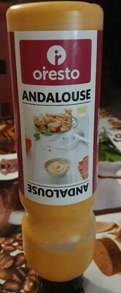
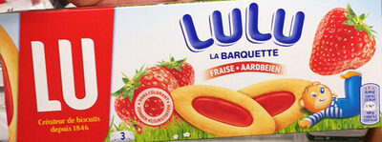
Oldest and Newest Products
Oldest
Newest
Notes:
Lulu La Barquette Fraise: Snacks, Snacks sucrés, Biscuits et gâteaux, Biscuits, Barquettes aux fruits, Biscuits à la fraise, Barquettes à la frais
Andalouse: No categories

Slide 5
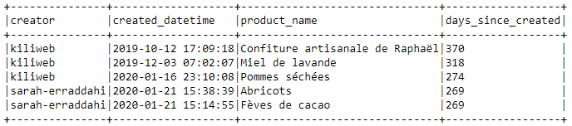

Average Product Age
1
Created new column with the number of days between when the product was created and this presentation
Calculated the average of the days_since_created column
2

Slide 6
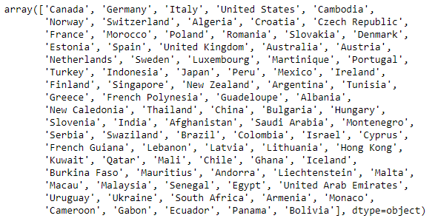
List of Other Countries Products are Sold to
88 Different Countries

Slide 7
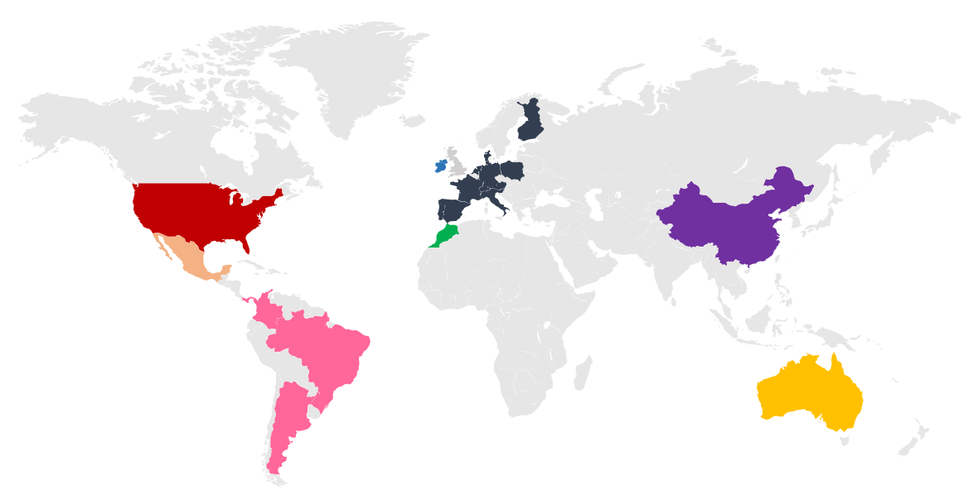
List of Other Countries Products are Sold to
14815
37
169
53
39
34
16
115
88 Different countries

Slide 8
Number of Products by Category
Plant-based
Beverages
Snacks
Dairies
9692
2581
4292
1816
Cereals & Potatos
Fermented food
Fruits and Veg. Based food
Ferm. Milk Products
1776
1339
1321
1305
there are 2416 different categories, and 34388 products without a category in the original dataset

Slide 9
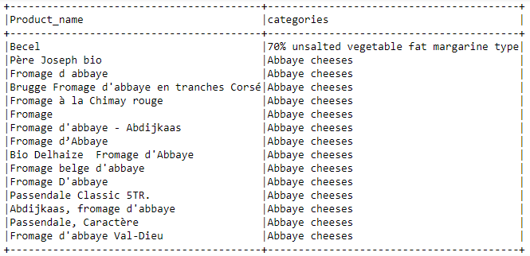
List of Products by Category

Slide 10




Number of Products by Trace
Nuts
Milk
Soybeans
Gluten
1944
1303
4292
1816
Eggs
Sesame Seeds
Peanuts
Celery
1776
1339
1321
1305
there are 64 different traces, and 46360 products without a trace in the original dataset
Notes:
8% ff the rows we can know the traces the product might have. This is one of the rows with the least amount of data

Slide 11
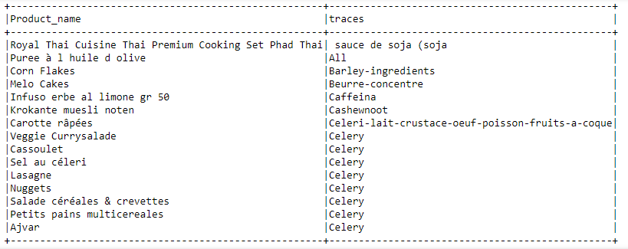
List of Products by Trace

Slide 12
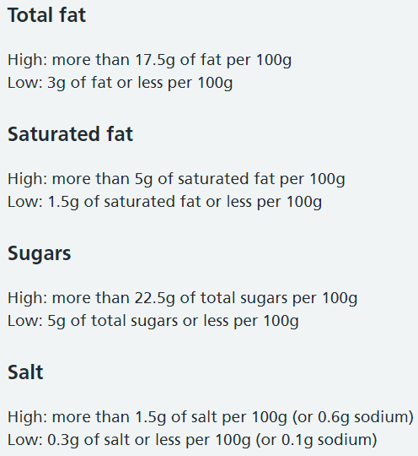
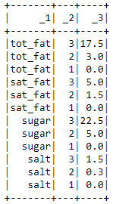

What is Healthy?

Slide 13
Classifying Healthy
Unhealthy
Medium
Healthy
Incomplete Info
Health Score >= 9
Health Score 7 or 8
Health Score <= 6
Health Score ?
8.5% of Products
22% of Products
47.7% of Products
23.4% of Products

Slide 14
Distribution of healthy products on the data throughout the years
2012
12% of unhealthy
16% of medium
51% of Healthy
21% of incomplete
2016
13% of unhealthy
22% of medium
45% of Healthy
20% of incomplete
2020
8% of unhealthy
23% of medium
48% of Healthy
21% of incomplete
2014
15% of unhealthy
22% of medium
45% of Healthy
18% of incomplete
2018
11% of unhealthy
23% of medium
50% of Healthy
16% of incomplete

Slide 15


Characterization of Unhealthy Products
29gr
34gr
Fats
Sugar
15gr
1.16gr
Sat. Fats
Salt
Categories with most products
Unhealthiest products
Snacks, Sweet snacks, Biscuits and cakes, Chocolates, Plant-based foods and beverages, Plant-based foods, Confectioneries, Breakfasts
Biscuits assortiment | 12
kerrie ananas saus | 12
Nestlé Nan Pro 3 Lait De Croissance | 12
NAN A.R. 2 | 12
Petrella | 11

Slide 16
Characterization of Medium Products
29gr
9.7gr
Fats
Sugar
9.8gr
1.7gr
Sat. Fats
Salt
Categories with most products
Common products
Dairies, Plant-based foods and beverages, Fermented foods, Snacks, Cereals and potatoes, Groceries
Doritos spicy sweet chilly | 8
The Original Caesar Dressing | 8
Hershey's milk chocolate drops | 8
Frosted vanilla milkshakeç | 8
Caffé Monster | 8

Slide 17
Characterization of Healthy Products
3gr
10.4gr
Fats
Sugar
0.7gr
0.8gr
Sat. Fats
Salt
Categories with most products
Healthiest products
Plant-based foods and beverages, Beverages, Cereals and potatoes, Fruits and vegetables based foods, Meals, Cereals and their products, Breakfasts
Peches demi-fruits Au jus | 4
Fruit de Jacques vert dans de l'eau salée | 4
Roasted vegetable | 4
Tabasco sauce | 4
Cramberry Classic light | 4

Slide 18
Technical Questions and Recommendations
Certain key fields should be non-nullable.
Null Values
1
There needs to be a unique identifier and with duplicates in the code column, there isn’t
Unique Identifier
2
Will the input of new data be limited to ensure quality?
New Data
3
How frequently is the data being checked for accuracy and updated?
Update Data
4
What system will be put in place to ensure that data remains consistent with itself?
Data Governance
5

Slide 19
Business Questions and Recommendations
How frequently are the different products purchased?
Quantity Purchased
1
What approach should be taken to fill in key null values?
Data Cleaning
2
What is important for a healthy diet?
Health Recommendations
3
How will combinations of products into a meal be taken into account for a healthy diet?
Product vs Meal
4
Saving the world is great but how will ACME Corp monetize this info?
Monetize
5

Slide 20
Thank you!
Nicolas Boer
Rebecca Rosser
Alberto de Ronni
Stefano Magnan
Laura Frazer
Eleonora Jiménez

